Slide 1
Applied data science capstone Michigan microbrewery
2020/04/10
Kevin Duncan

Slide 2
Agenda
1. Background
2. Objectives
3. Planned Outputs

Slide 3
1. background
Craft Beer is popular in the United States, with a rapid expansion of Microbreweries across the Northeast, Michigan, and Northwest.
As of Calendar Year end 2017, there were over 6,200 Craft Breweries (Table 1).
Craft Brewing is potentially very profitable, especially once establishing distribution.
However, due to the expansion of Craft Brewing, new startups need to choose location wisely as the density of breweries increase in residential areas.
Key Point: If opening a Microbrewery, need to choose carefully to avoid jumping into a saturated market.

Slide 4
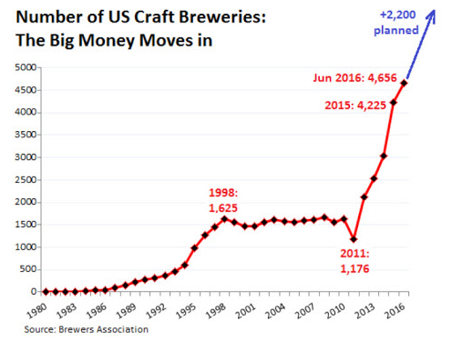
1. background
(Table 1 – Craft Breweries in the United States)
Key Point: If opening a Microbrewery, need to choose carefully to avoid jumping into a saturated market.

Slide 5
2. OBJECTIVE
You have been recruited to assist a up and coming Midwestern Microbrewery, Great Divide Brewing, in locating a brewery and taproom in Michigan
Great Divide sells well with Household incomes over $75,000.
It offers a lineup of premium Microbrew styles, ranging from Bold IPAs to Easy Drinking Pilsners that appeal to more affluent and established professionals.
Your objective is to find a Neighborhood in Michigan that meets these criteria but also has a low density of Breweries and Bars.
Neighborhoods should have a population greater than 15,000 to ensure sufficient sales demand.
Key Point: Find a Neighborhood with Income ≥$75k, pop ≥15,000, and minimum Bar/Brewery density.

Slide 6
3. Planned outputs
Scrape or load Census data for Counties in Michigan that have for Household Income >$75k/year.
Scrape or load Census data for Neighborhoods within County that have Population >15K.
Use Foursquare to obtain Venue information for Neighborhoods.
Rank Venues based on prevalence for each Neighborhood, to understand types of venues are popular.
Cluster related Neighborhoods to look for areas with various types of eateries, social gathering places, that have a low density of Bars and Breweries.
Present findings and recommendations from Neighborhood Clusters.
Key Point: Scrape or load Census Data to get Demographic info. Use Foursquare to obtain Venues and popularity for Cities of interest. Cluster Cities to look for areas that have low occurrence of Bars/Breweries.

